Slide 1


JEPPIAAR ENGINEERING COLLEGE DEPARTMENT OF COMPUTER SCIENCE AND ENGINEERING SB WORKS - FREELANCING APPLICATION MERN
TEAM LEADER : M.KAMESH(310821104046) SUPERVISOR NAME : MRS.D.JEEVITHA ,M.E
TEAM MEMBER - 1 : E.MADESH(310821104050) ASSISTANT PROFESSOR /CSE
TEAM MEMBER - 2 : J.MAGESH(310821104053)
TEAM MEMBER - 3 : R.MADHESH(310821104052)
TEAM MEMBER – 4 : J.ABIYOUTH SHALVIN(310821104301)

Slide 2
TEAM MEMBERS AND ROLES
Kamesh M - Project Manager
Madesh E - Frontend Developer
Madesh R - Backend Developer
Magesh J - Database Administrator
Abiyouth Shalvin J - QA and Testing Specialist

Slide 3
PROJECT OVERVIEW
SB Works is designed to simplify and secure the freelancing experience by connecting clients with freelancers through a robust and intuitive platform. It enables clients to post projects and find skilled freelancers, while freelancers can bid on projects suited to their expertise.
Key Features:
Project Posting and Bidding
Profile Management
Secure Communication
Admin Oversight

Slide 4
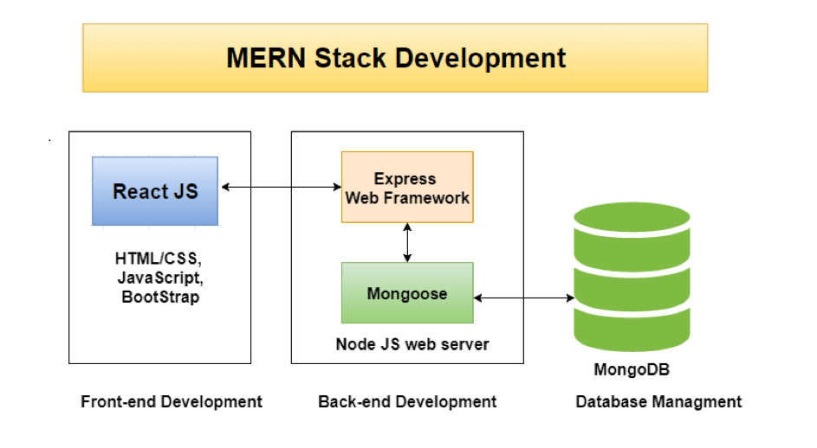
ARCHITECTURE

Slide 5
FRONTEND
React.js
Bootstrap and Material UI
Axios Library
BACKEND
Node.js with Express.js
RESTful APIs
Middleware
DATABASE
MongoDB

Slide 6
SETUP INSTRUCTION
PREREQUISITES
Node.js
MongoDB
2. INSTALLATION STEPS
Cloning the Repository : Git clone https://github.com/Kamesh-091203/Freelancing-Application-MERN-.git
Install Dependencies : npm install
CONFIGURE : .env

Slide 7
FRONTEND
The Frontend is the client-facing part of the application that users interact with. It includes the user interface (UI) design, elements, and user experience (UX) logic.
It handles the presentation layer, ensuring responsive and visually appealing designs.It communicates with the backend via API calls to display dynamic data.
TECHNOLOGIES USED:
React.js is a Main framework for building the user interface.Bootstrap and Material-UI is used for styling and responsive design.Axios is used for API requests to communicate with backend.
STRUCTURE COMPONENTS :
Reusable Components: Buttons, Modals, etc.
Page-Specific Components: Dashboard, User Profiles, Job Listings.

Slide 8
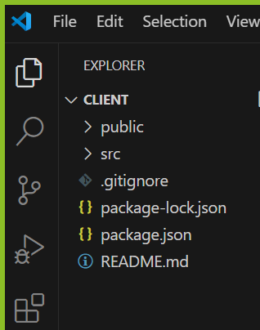
FOLDER STRUCTURE:

Slide 9
ROUTING:
React Router is used for SPA (Single Page Application) navigation.
KEY FILES:
/src/index.js: Entry point for the React app.
/src/components: Holds all reusable and page-specific components.
/src/services: Manages API calls.
/src/styles: CSS/SCSS files for styling.
RUNNING THE APPLICATION:
Navigate to the Frontend Directory : cd client
Install Dependencies : npm install
Start the Development Server : npm start
Access the Application: http://localhost:3000

Slide 10
FEATURES:
User login/register forms.
Dashboard for freelancers and clients.
Job posting and application forms.
Real-time updates.
BACKEND
The Backend is the server-side part of the application that processes requests, applies business logic, and manages data flow between the frontend and the database.
It handles APIs (Application Programming Interfaces), user authentication, and authorization.Tools like Node.js and Express.js are used to build a scalable backend.

Slide 11
TECHNOLOGIES USED:
Node.js is used for Runtime environment and Express.js is a Framework used for handling routes and middleware.
APIs STRUCTURE:
User authentication:Login, Registration, JWT-based authentication.
CRUD operations:Job postings, user profiles, applications.
Real-time communication: Notifications or chat features.
MIDDLEWARE:
Authentication Middleware: Verifies JWT tokens for secured routes.
Validation Middleware: Ensures data integrity using libraries like Joi or Validator.js
ERROR HANDLING:
Centralized error-handling middleware for catching errors.

Slide 12
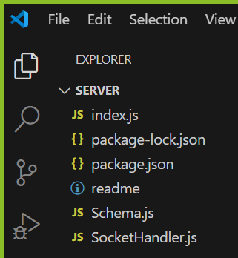
FOLDER STRUCTURE:

Slide 13
KEY FILES:
/routes: Contains API endpoints for users, jobs, applications, etc.
/controllers: Handles business logic.
models: Defines Mongoose schemas.
/server.js: Initializes the Express server.
RUNNING THE APPLICATION:
1. Navigate to the Backend Directory : cd server
2. Install Dependencies : npm install
3. Set Up Environment : .env
PORT=5000
MONGO_URI=your_mongodb_connection_string
JWT_SECRET=your_jwt_secret
4. Start the Server :

Slide 14
For Production : node server.js
For Development : npx nodemon server.js
5. Verify the Server : http://localhost:5000.
DATABASE
Database is the storage system where all persistent data, such as user profiles, job listings, and applications, is stored.MongoDB is a NoSQL database used for flexible schema designs.The database ensures data consistency, reliability, and easy retrieval.
TECHNOLOGY USED :
MongoDB: A NoSQL database.
COLLECTIONS STRUCTURE :
users: Stores client and freelancer profiles.
jobs: Contains details of job postings.
applications: Tracks freelancer applications for jobs.
messages: For chat functionality.

Slide 15
SCHEMA DESIGN:
Example:
User Schema
const UserSchema = new mongoose.Schema
({
name: String,
email: { type: String, unique: true },
password: String,
role: { type: String, enum: ['client', 'freelancer'] },
createdAt: { type: Date, default: Date.now }
});
RELATIONSHIPS:
Use references (ObjectId) for linking collections (e.g., applications linked to users and jobs).

Slide 16
STEPS TO CONNECT MongoDB:
Install MongoDB Driver : npm install mongoose
Configure MongoDB URI : mongodb://localhost:27017/Freelancing
Set Up Environment Variable : MONGO_URI=mongodb+srv://<username>:<password>@cluster0.mongodb.net/Freelancing?retry Writes=true&w=majority
4. Connect to MongoDB Using Mongoose :
const mongoose = require('mongoose’);
require('dotenv').config();
const connectDB = async () => {
try {
await mongoose.connect(process.env.MONGO_URI, {
useNewUrlParser: true,
useUnifiedTopology: true, });
console.log('MongoDB Connected'); }
catch (error) {
console.error('Error connecting to MongoDB:', error.message);
process.exit(1);}};
connectDB();

Slide 17
5. Start Your Application : node server.js
6. Verify Connection : Check for the MongoDB Connected message in the console.
TESTING
Testing ensures the reliability, performance, and accuracy of the application. It identifies and resolves bugs or issues before deploying the application.Includes unit, integration, and end-to-end testing for all application layers.
TYPES OF TESTING
1. Frontend Testing :
Unit Testing : Test individual React components using libraries like Jest,React and User Events Testing Library.
Integration Testing: Test component interactions.
End-to-End (E2E) Testing: Test the whole flow using Cypress or Playwright.

Slide 18
STEPS TO PERFORM FRONTEND TESTING :
1. Set Up Testing Library:
npm install --save-dev jest
@testing-library/react
2. Write Unit Tests : Test individual components.
import { render, screen, fireEvent } from '@testing-library/react’;
import Button from './Button’;
test('renders button and handles click', () => {
const handleClick = jest.fn();
render(<Button onClick={handleClick}>Click Me</Button>); fireEvent.click(screen.getByText('Click Me')); expect(handleClick).toHaveBeenCalledTimes(1);
});
3. Integration Tests : Test how components interact together.
4. End-to-End (E2E) Tests:
npm install cypress
npx cypress open
5. Run Tests: npm test

Slide 19
2. Backend Testing :
Unit Testing: Test individual API routes using Jest or Mocha.
Integration Testing: Test database and server interactions.
Testing: Use tools like Postman or automated scripts in Supertest.
STEPS TO PERFORM BACKEND TESTING :
Set Up Testing Framework : npm install --save-dev jest supertest
Write Unit Tests : Test individual functions or routes.
const request = require('supertest’);
const app = require('../server’);
test('POST /login - success', async () => { const res = await request(app).post('/login’).send({
email: 'test@example.com',
password: 'password123' });
expect(res.statusCode).toEqual(200);
expect(res.body).toHaveProperty('token');});

Slide 20
3. Integration Tests : npm install mongodb-memory-server.
4. Run Tests : npm test.
5. Check Coverage:Ensure that all code paths are covered using a coverage tool like nyc.
3. Database Testing :
Use libraries like Mongo Memory Server for testing database logic.
Validate schema constraints and query outputs.
STEPS TO PERFORM DATABASE TESTING :
Set Up Test Database : npm install mongodb-memory-server.
2. Test Schema Validations: Write tests to validate data models and
constraints.
const mongoose = require('mongoose’);
const User = require('../models/User’);
test('should not save a user without required fields', async () => {
const user = new User({ email: 'test@example.com' });
try { await user.save(); }
catch (error) { expect(error.errors.name).toBeDefined(); }});

Slide 21
3. Test CRUD Operations : Verify that data is correctly created, updated, retrieved, and deleted.
test('should create and retrieve a user', async () => {
const user = await User.create({ name: ‘NAME', email: ‘EMAIL ID' }); const fetchedUser = await User.findOne({ email: ‘EMAIL ID' }); expect(fetchedUser.name).toEqual(‘NAME');});
4. Mock Database for API Tests : Use mocks for database connections to isolate backend logic.
5. Run Tests : npm test
API DOCUMENTATION
API documentation in a project refers to a detailed description of the backend APIs (endpoints) that the application provides for interaction between the frontend (React) and the backend (Node.js/Express). It helps developers understand how to consume the API by explaining the available endpoints, methods, parameters, and responses.

Slide 22
ENDPOINTS:
Users: /api/users – Register, authenticate, and manage user profiles.
Projects: /api/projects – CRUD operations for project listings.
Bids: /api/bids – Submit and view bids on projects.
Chat: /api/chat – Facilitates communication between clients and freelancers.
AUTHENTICATION
Authentication is typically implemented to secure access to the application.
Methodology: JSON Web Token (JWT) is used to manage authentication and maintain secure user sessions.
Roles: User roles include client, freelancer, and admin, with different access levels.
Security Protocols: Tokens are validated on each request to secure endpoints from unauthorized access.

Slide 23
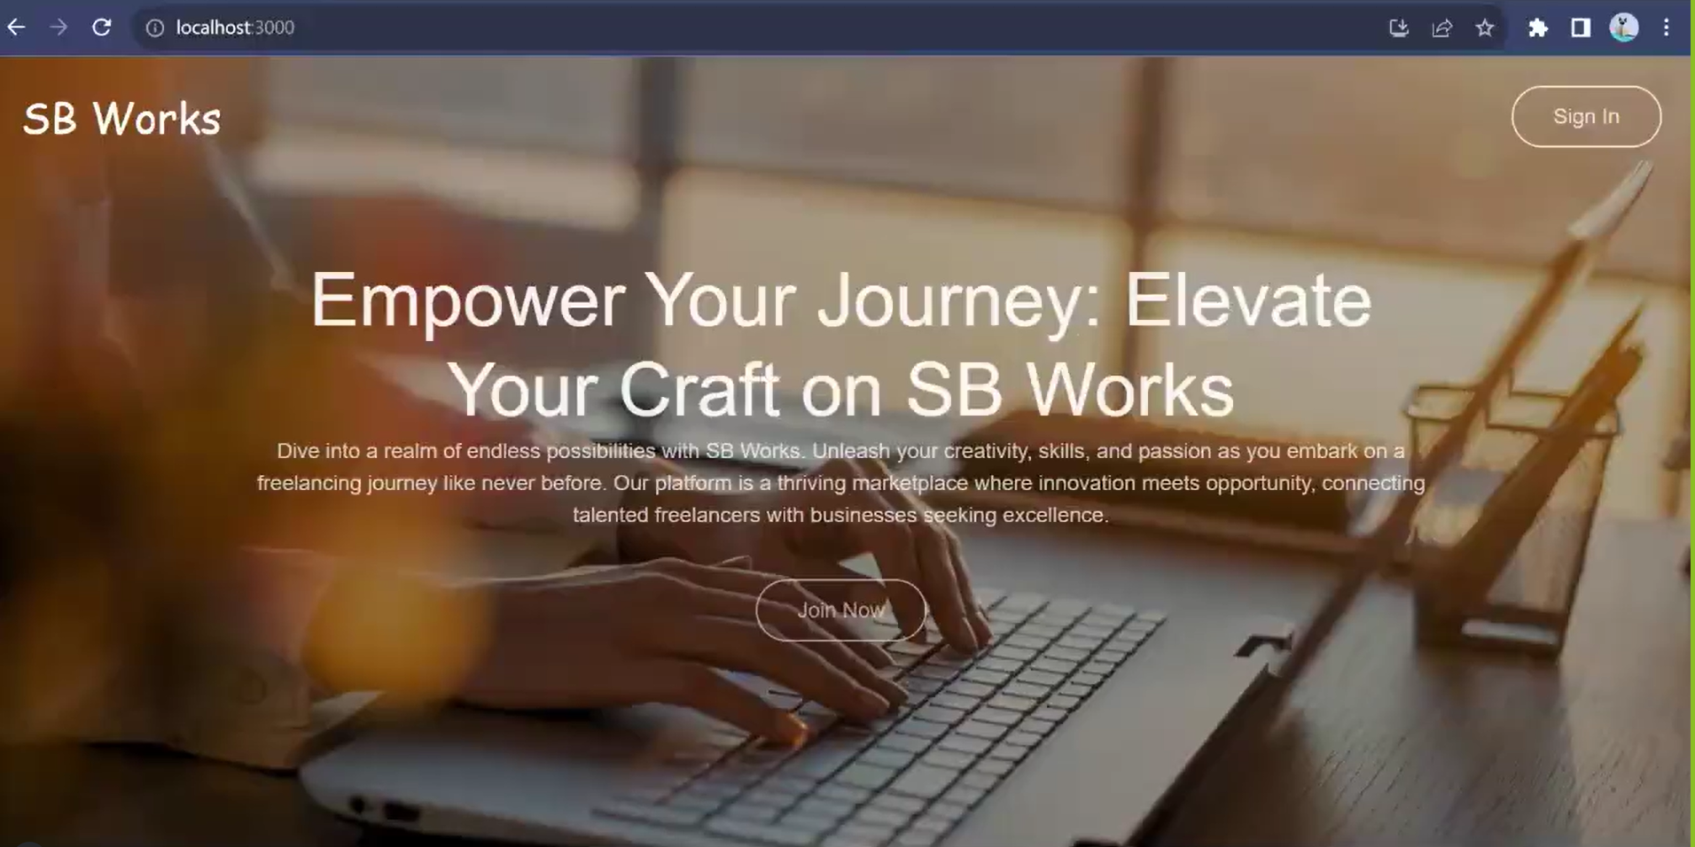
OVERALL FLOW OF APPLICATION Home Page

Slide 24
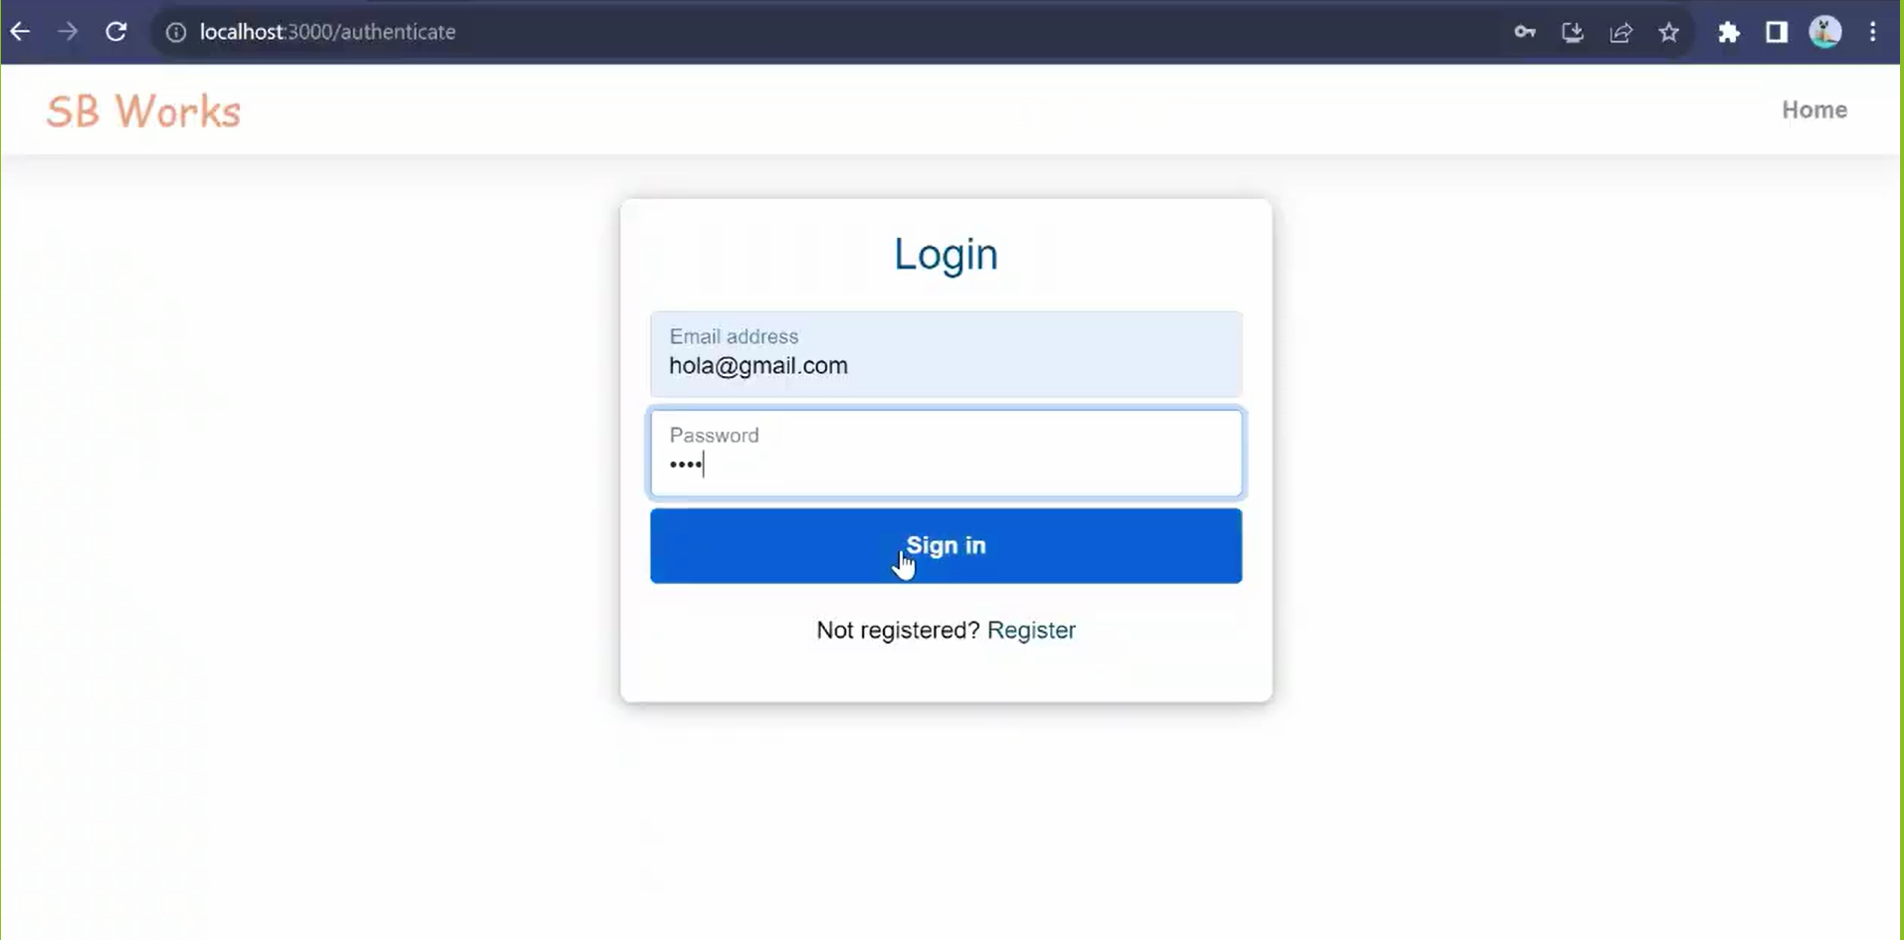
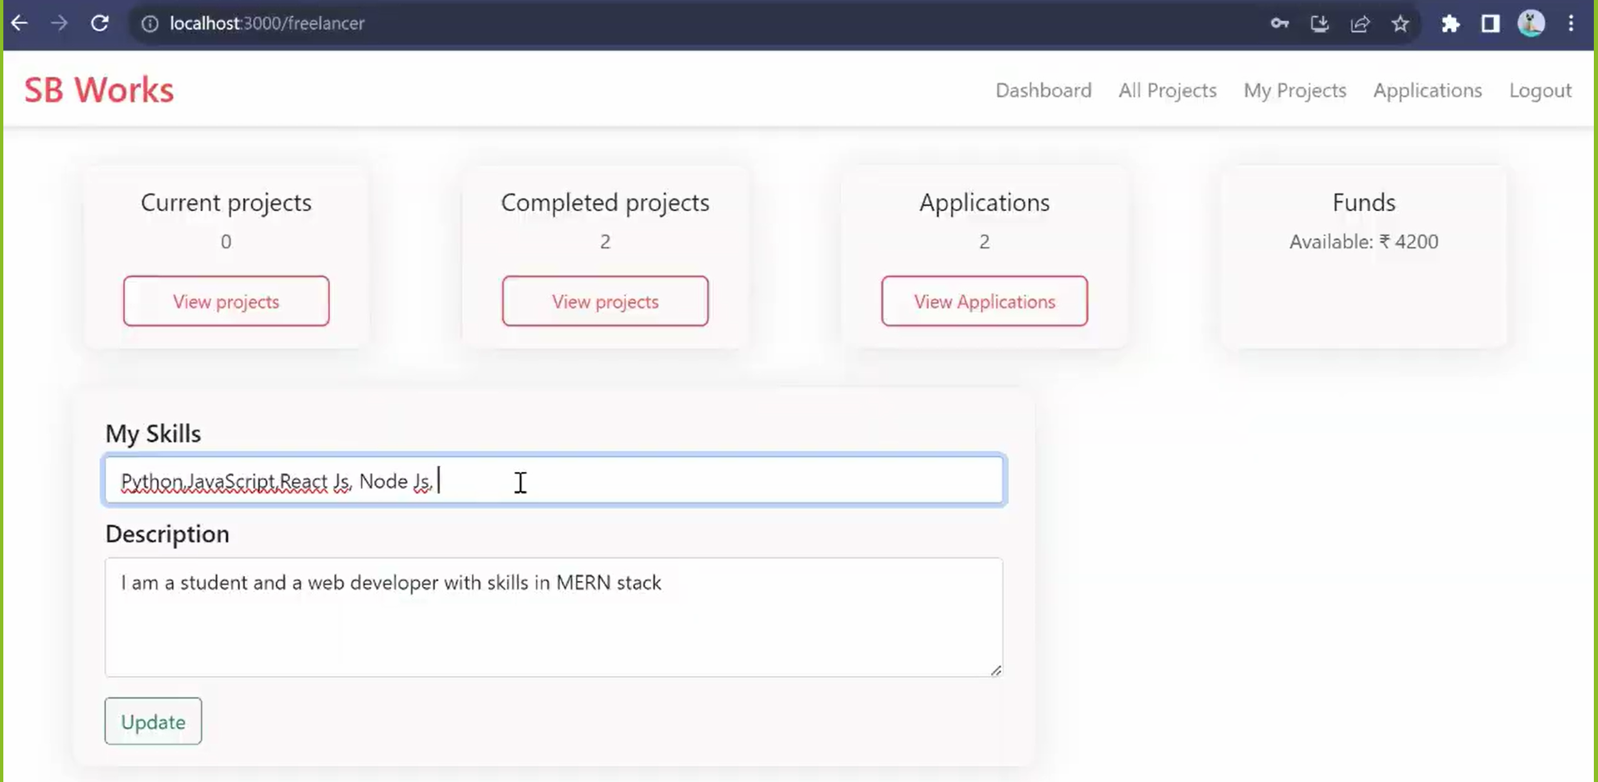
Freelancer Page

Slide 25
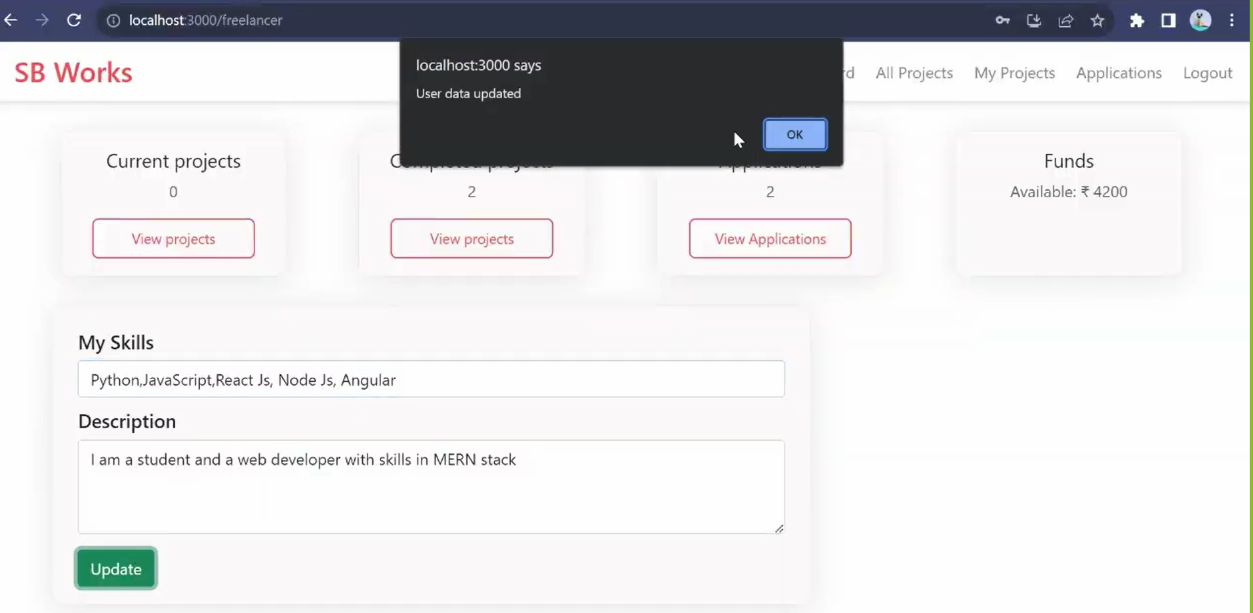
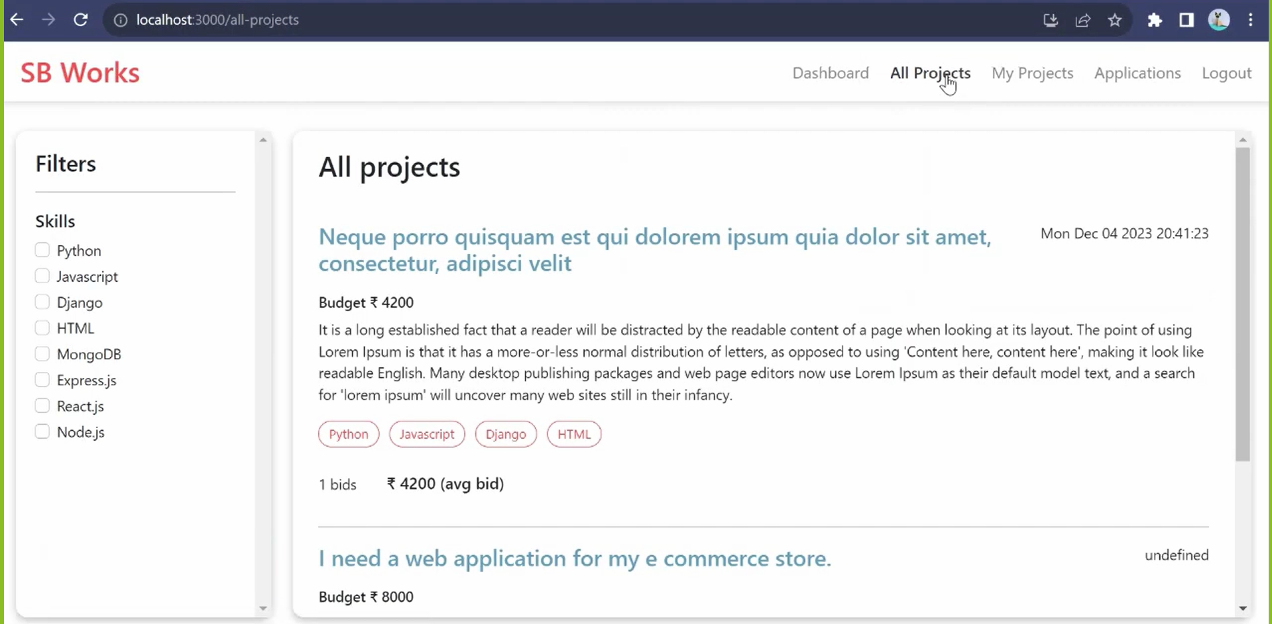
Freelancer Page

Slide 26
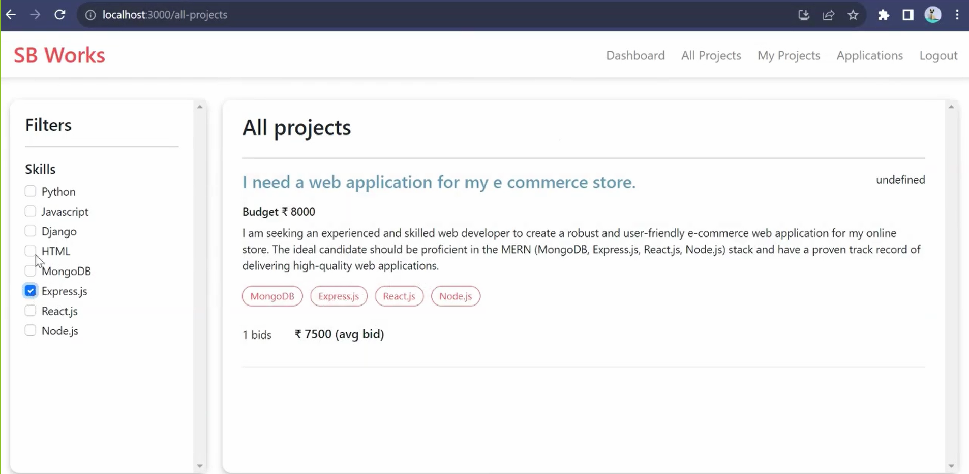
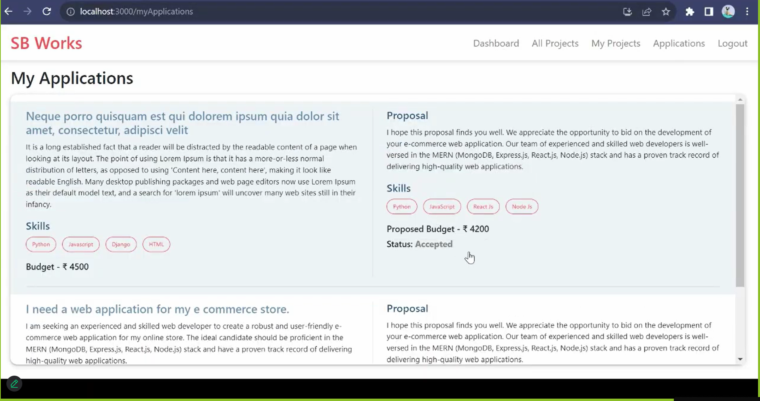
Freelancer Page

Slide 27
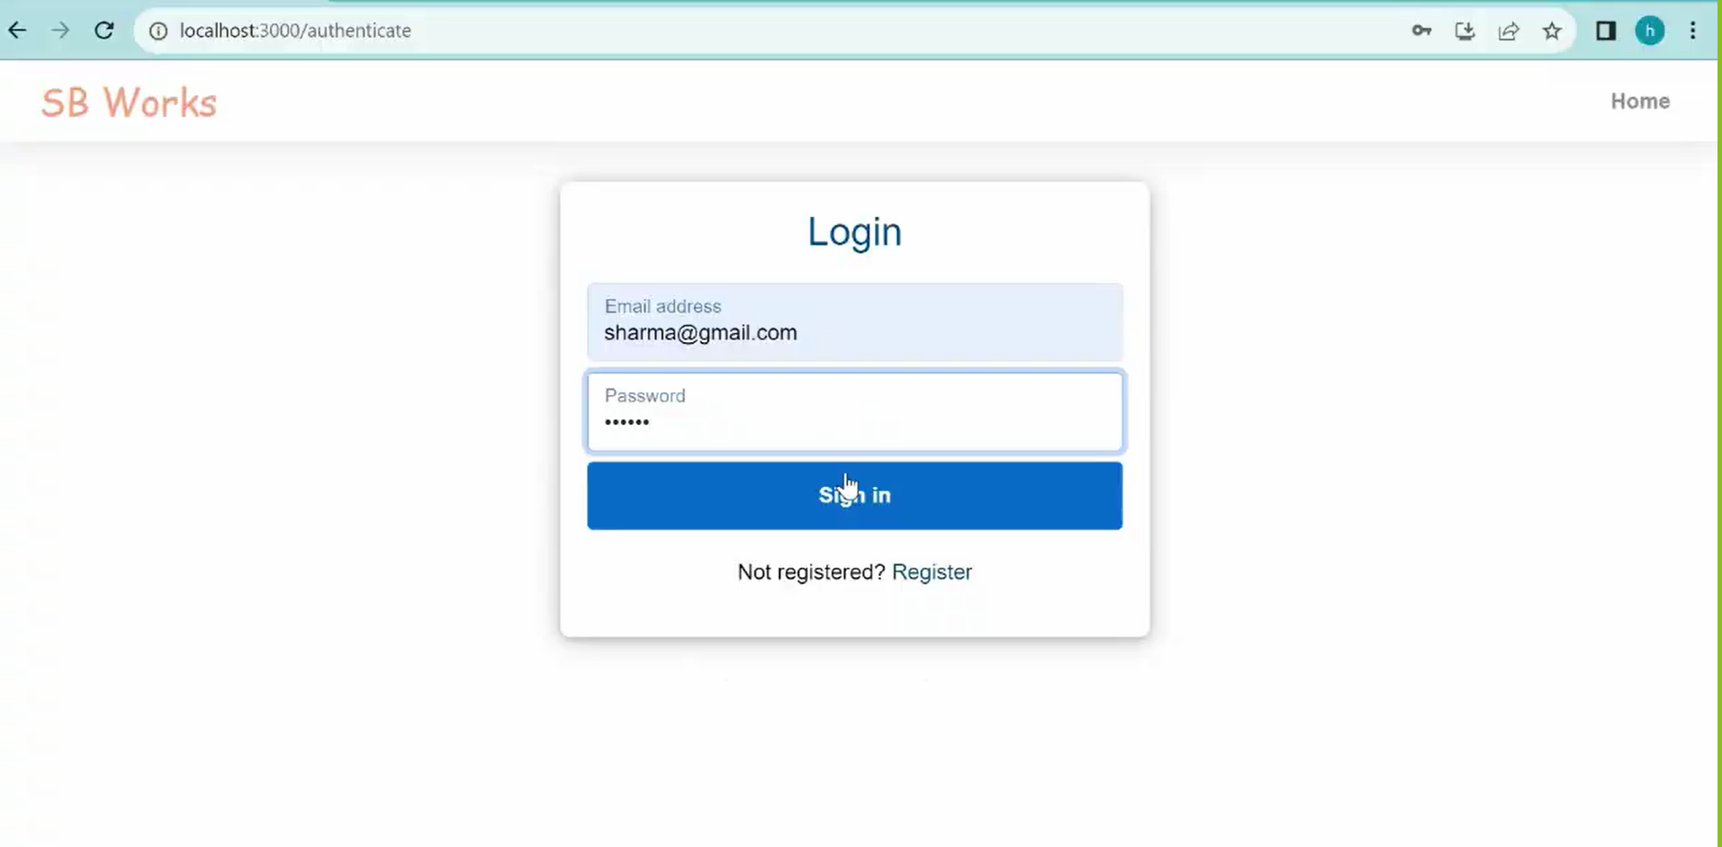
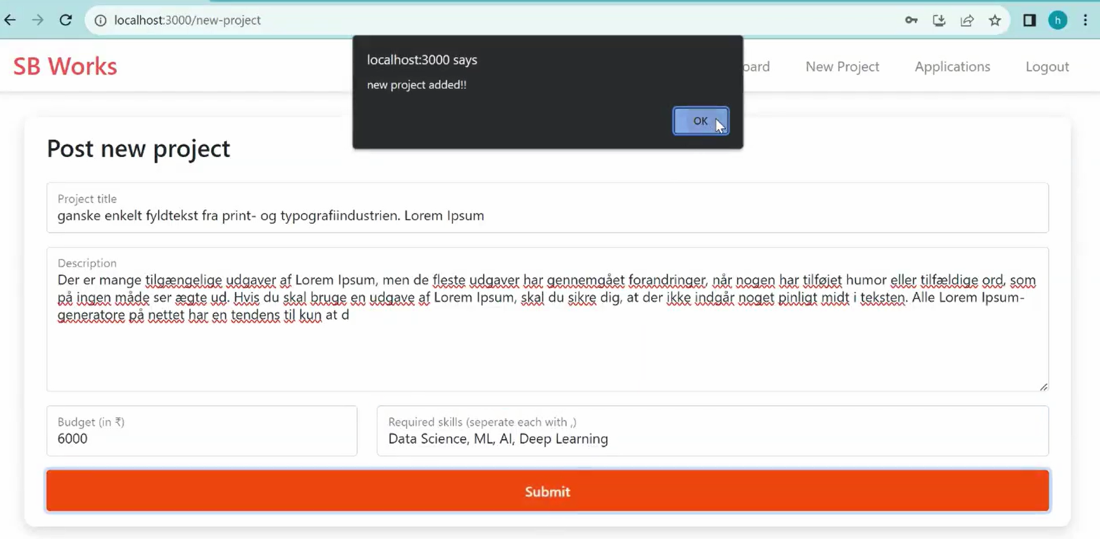
CLIENT PAGE

Slide 28
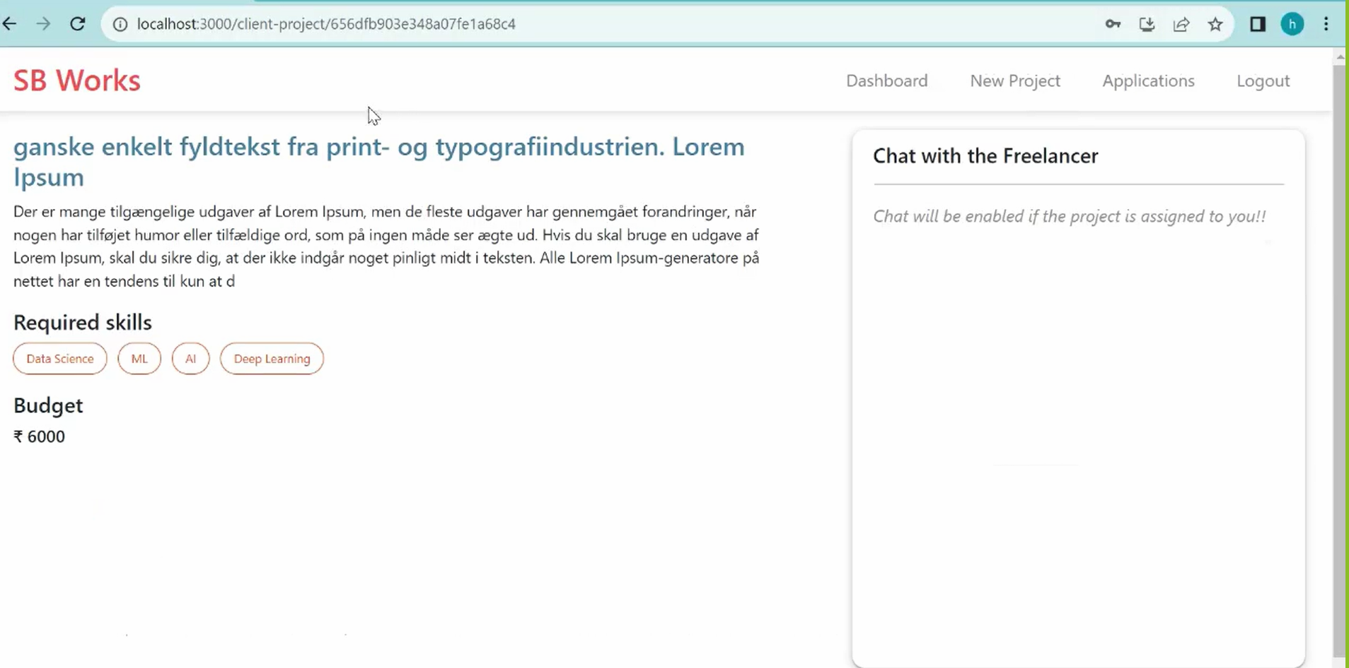
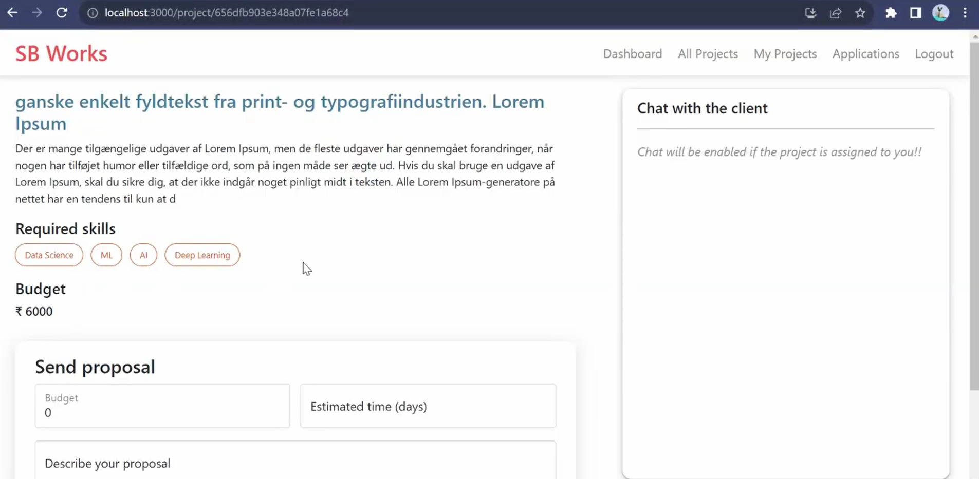
Client Page Freelancer Page

Slide 29
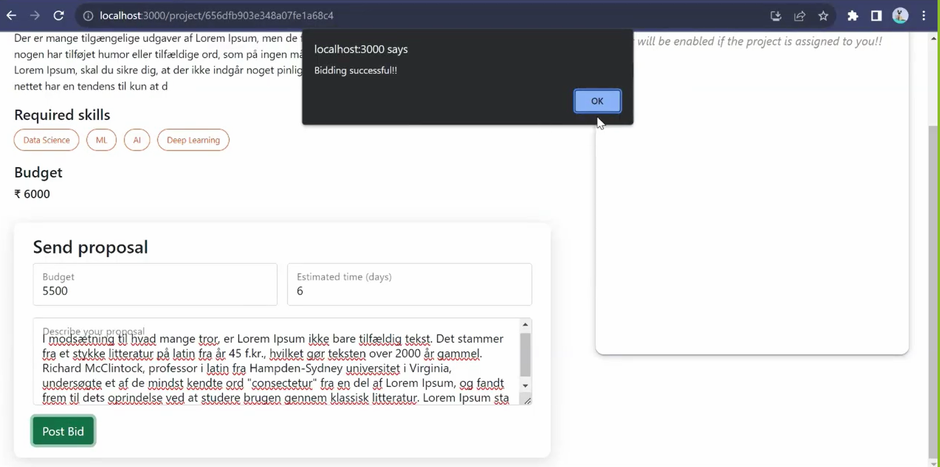
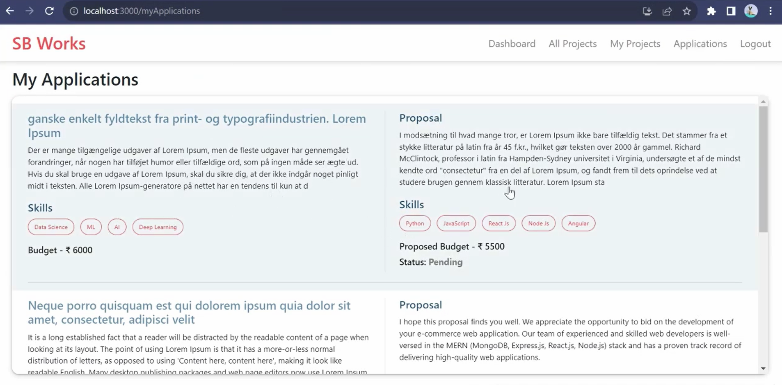
Freelancer Page

Slide 30
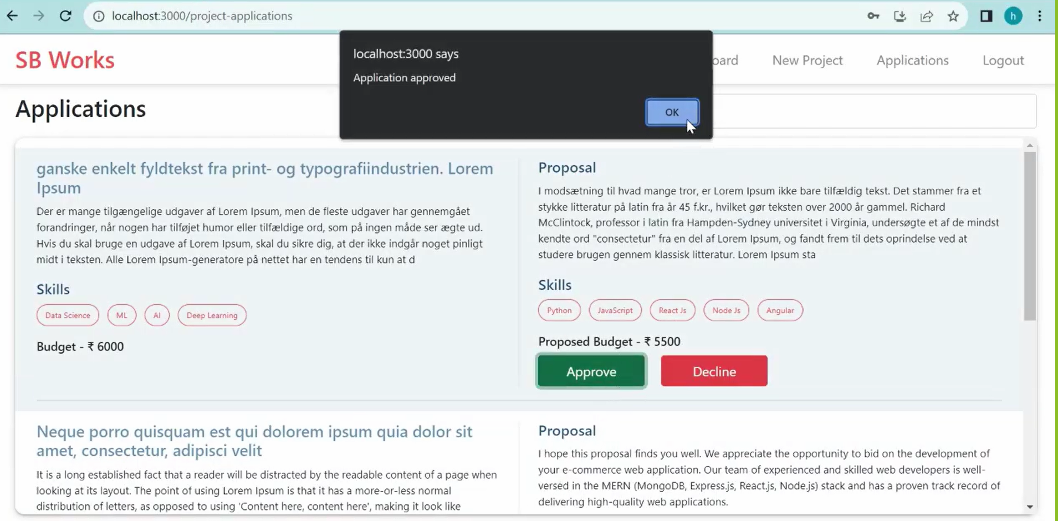
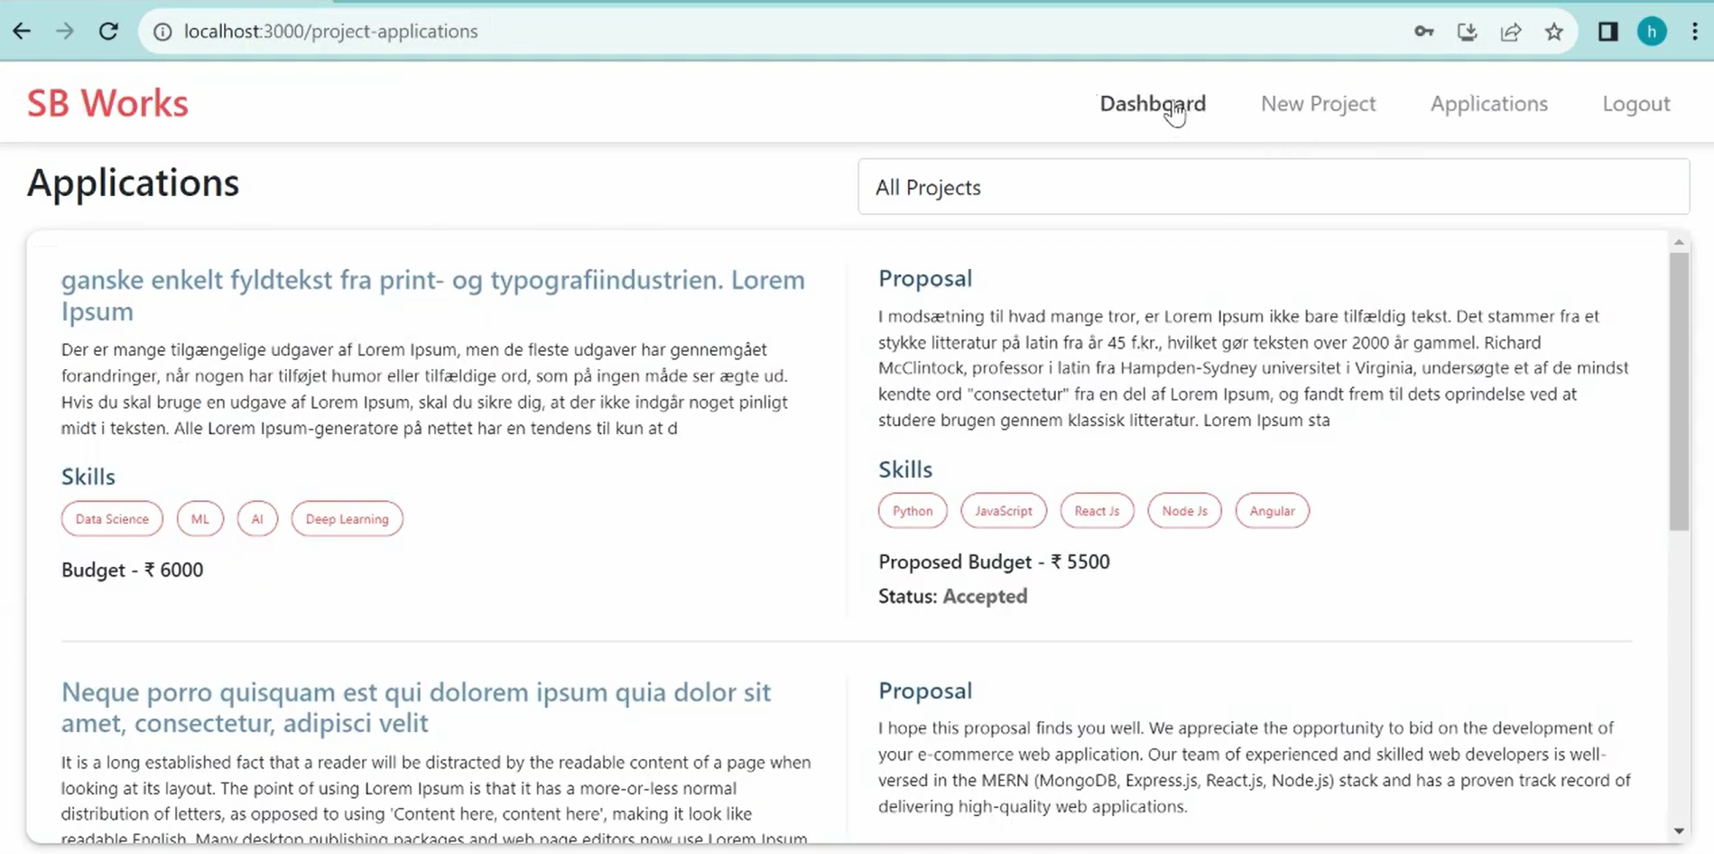
Client Page Freelancer Page

Slide 31
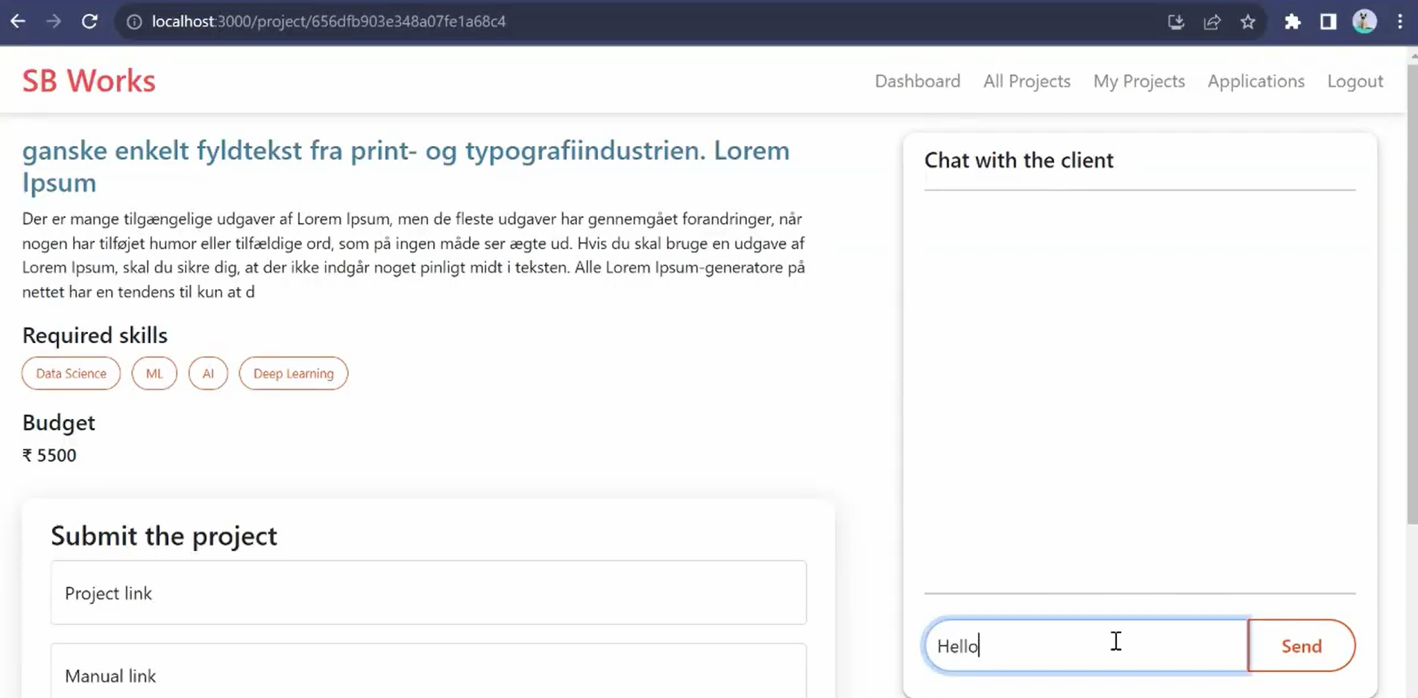
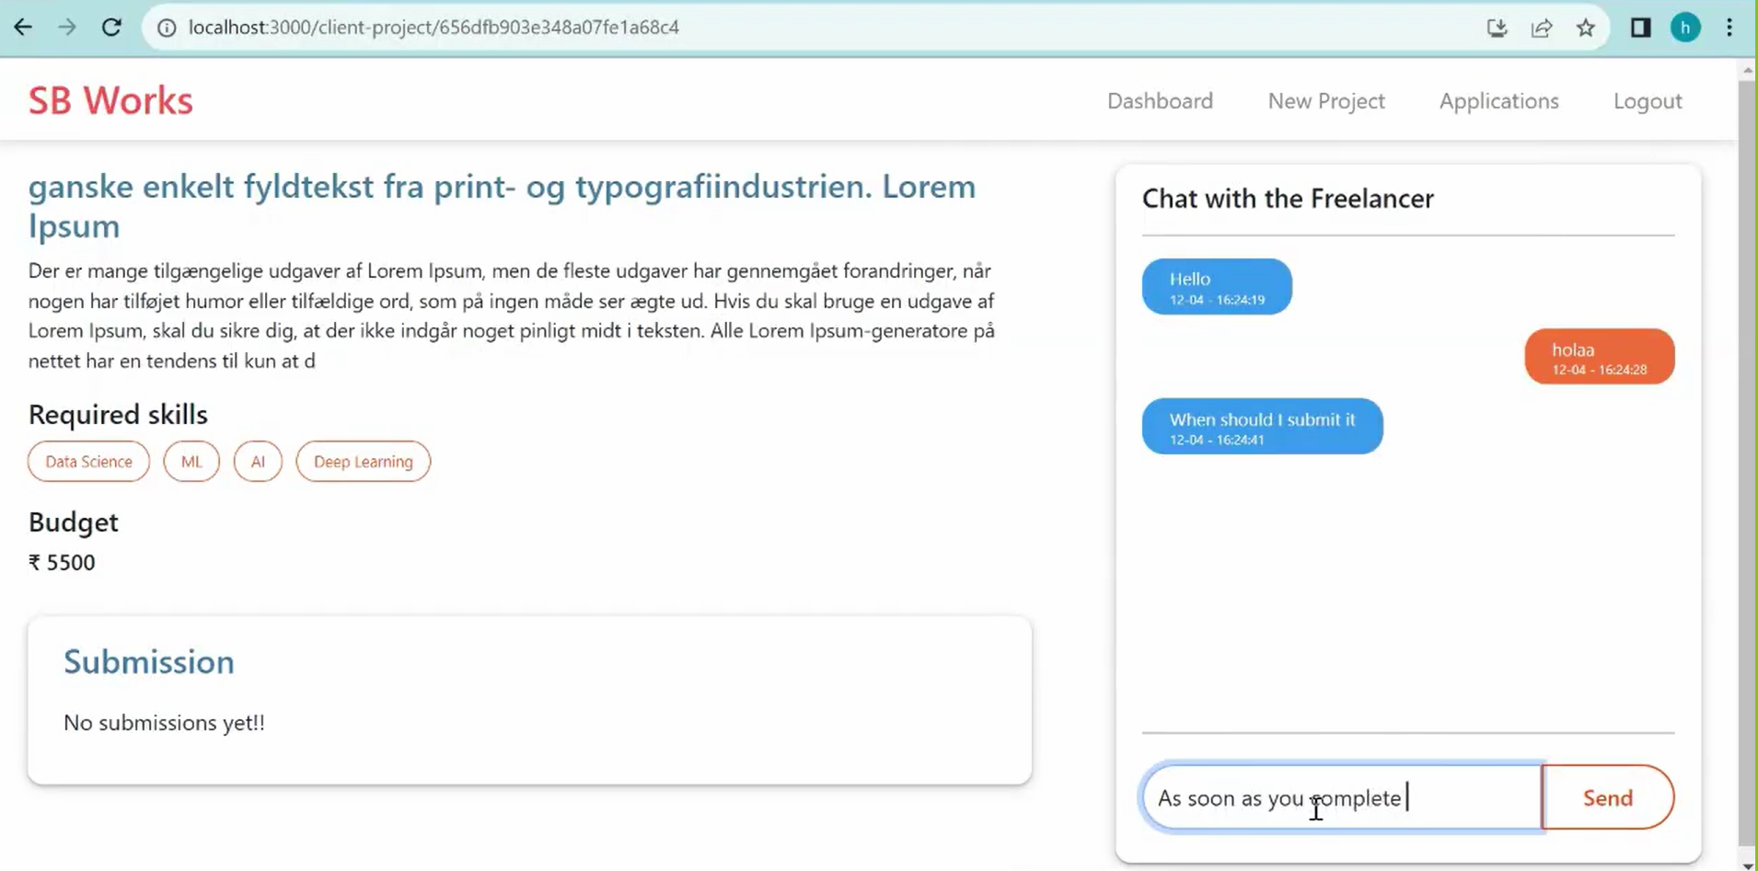
Freelancer Page Client Page

Slide 32
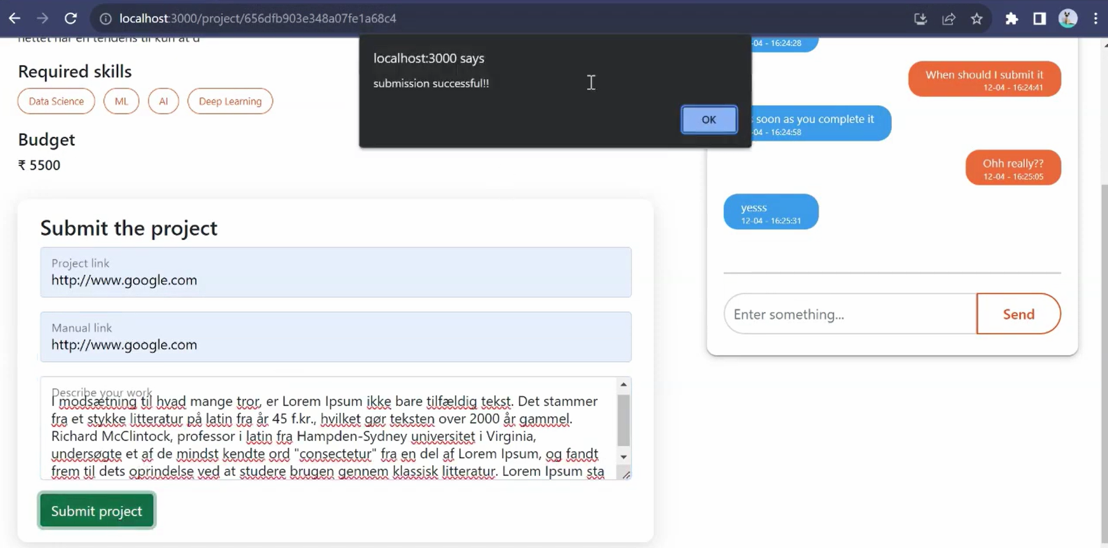
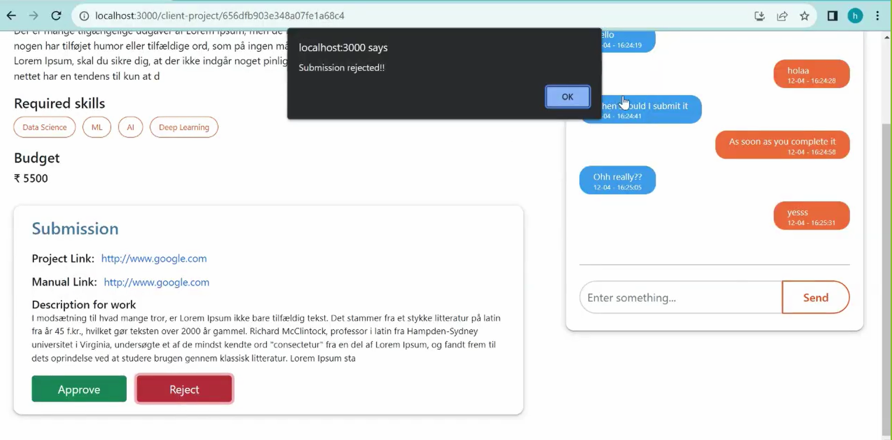
Freelancer Page Client Page

Slide 33
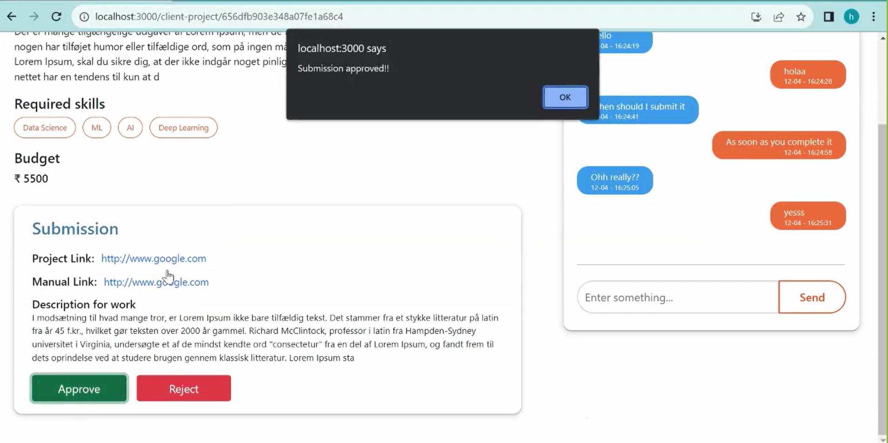
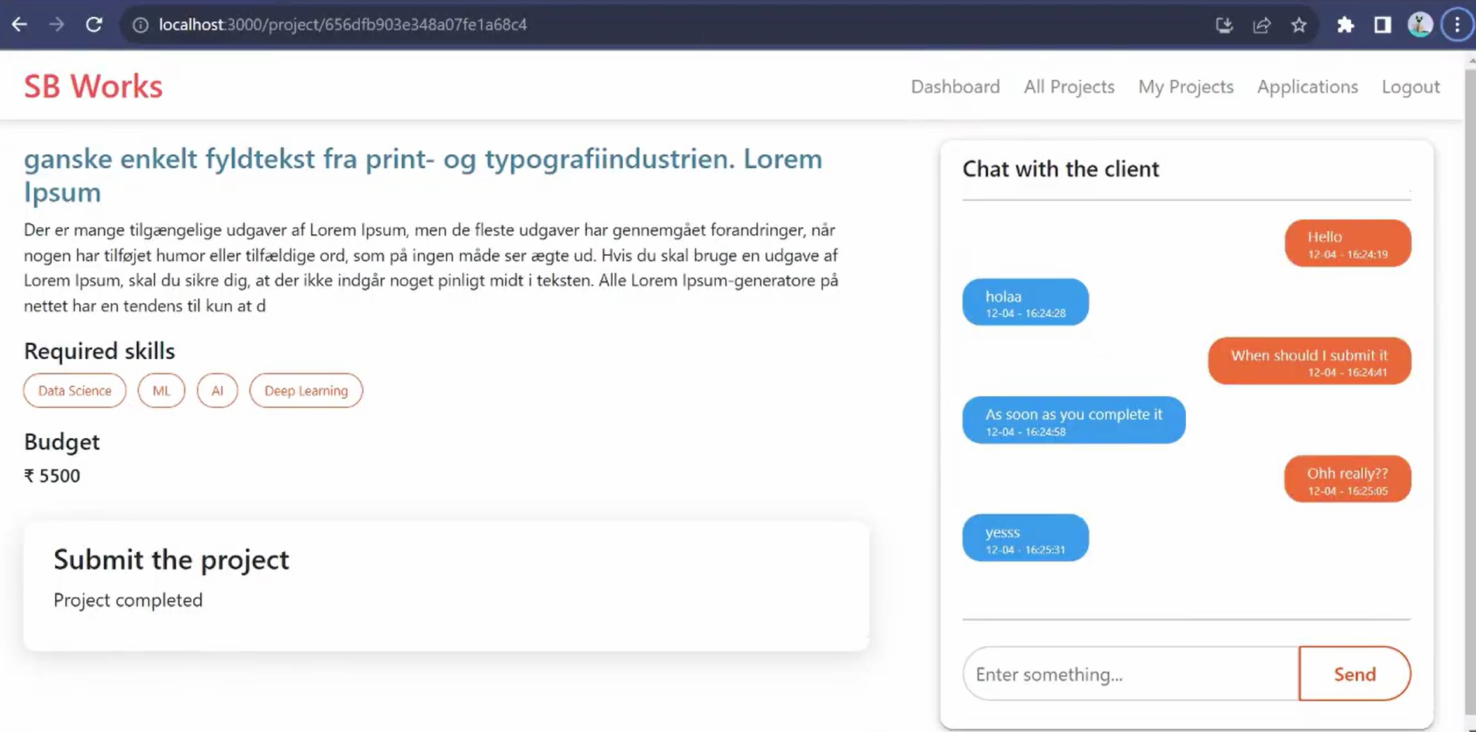
Client Page Freelancer Page

Slide 34
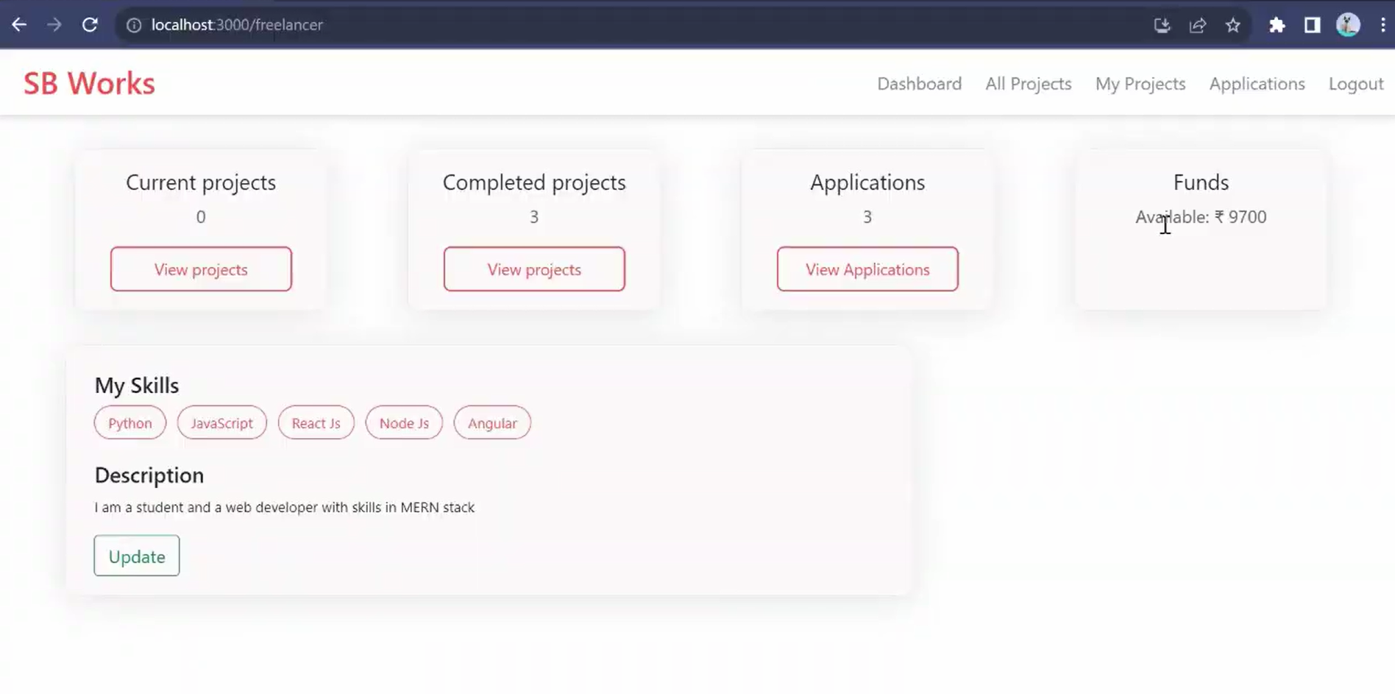
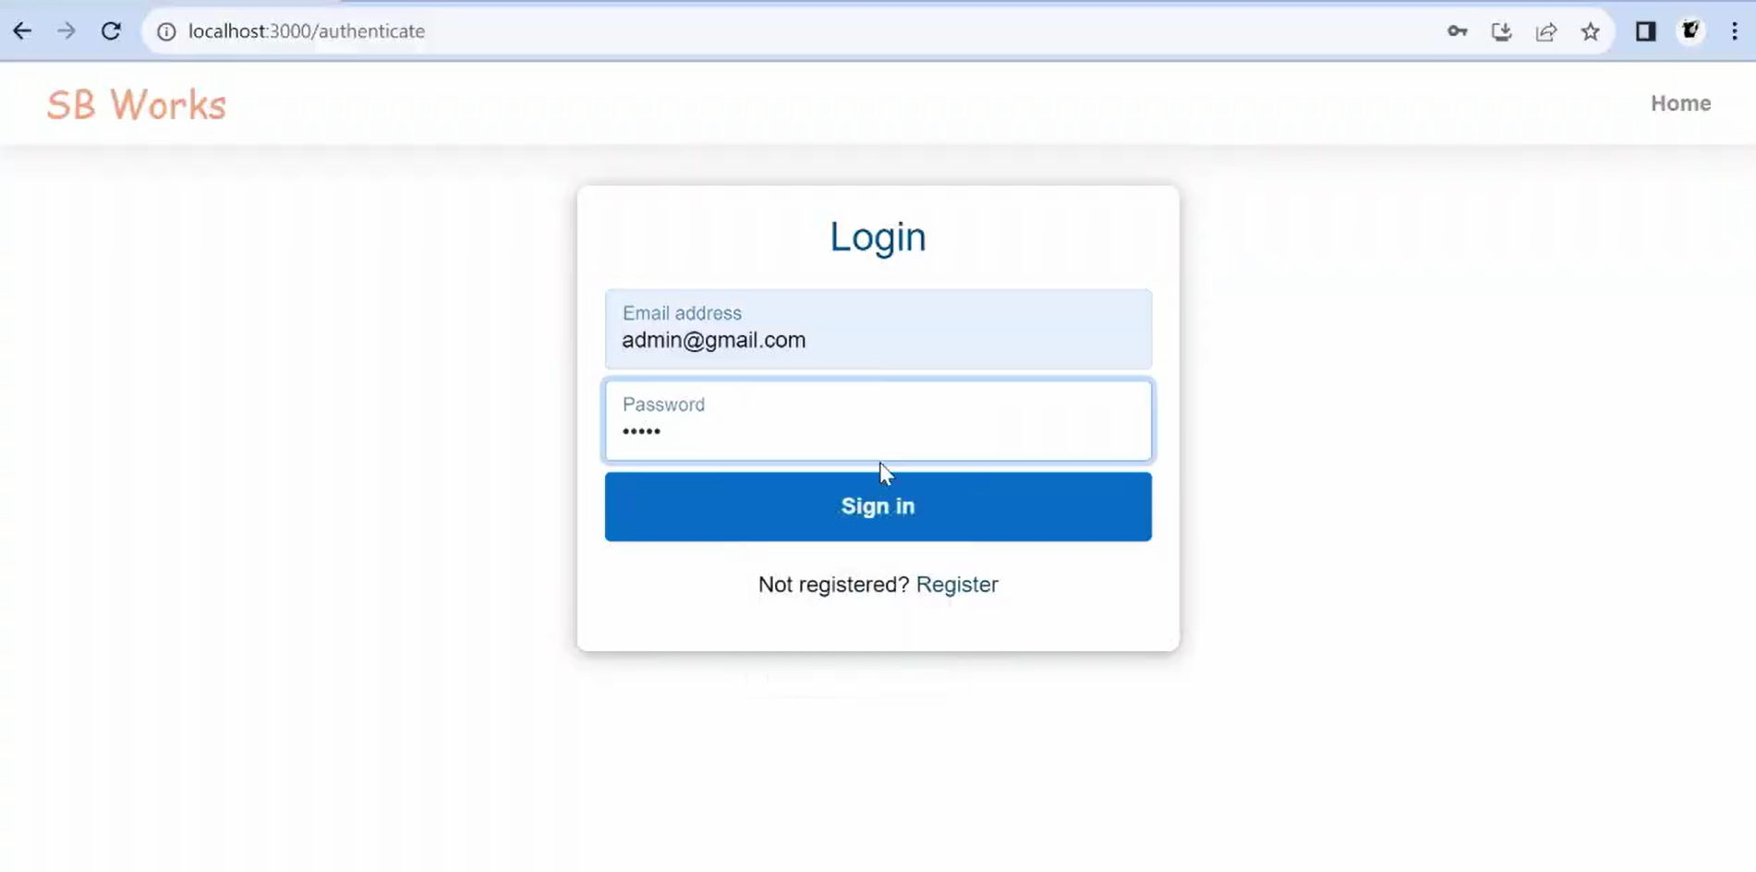
Freelancer Page Admin Page

Slide 35
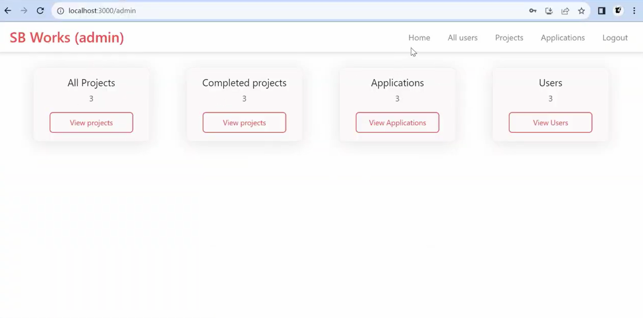
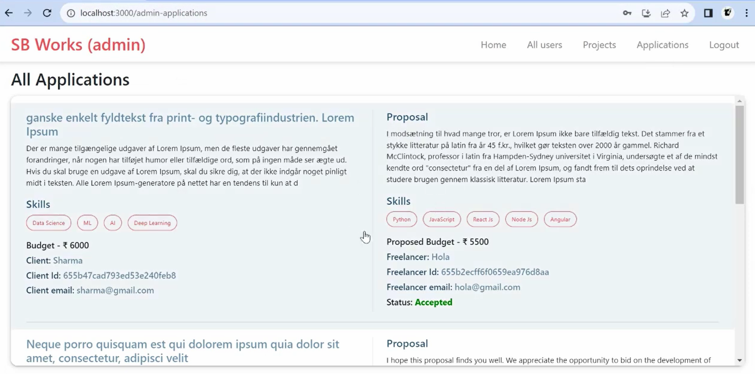
ADMIN PAGE

Slide 36
KNOWN ISSUES
Inconsistent layout on smaller screen sizes.
Occasional delays in real-time updates for notifications.
FUTURE ENHANCEMENTS
Advanced Filtering: Improved search and filtering options for projects and freelancers.
Payment Integration: Add secure payment options to streamline transactions on the platform.
AI-Based Matching: Integrate AI to recommend projects to freelancers based on skills and history.
User Ratings and Reviews: Allow clients to to rate freelancers,and
freelancers to provide feedback on client page.

Slide 37
Thank You!

